Slide 1
College or Career Option Project – Plans After High School

Slide 2
Each Student will select three (3) college/vocational school or three (3) job options after high school. *Note: Each student can work with another student with similar goals. If working with a partner, select a partner that share similar goals (college or work) after high school.

Slide 3
The project will consist six (6) things: 1. Flowchart 2. Power Point & Presentation(12-15 slides) 3. Budget Sheet 4. Letter of Recommendation (2) 5. Letter of Interest (college or work) 6. Resume

Slide 4
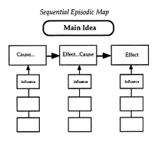
1. Flowchart - Write three (3) job options or three (3) college options. Put the necessary steps (map out the step-by-step procedures) to getting the job or getting accepted into the college in the flowchart.

Slide 5
2. Power Point (12-15 slides) Each student must present their project to get credit. It should outline the student’s plans after high school. No presentation, no credit! No partial credit for the written work (i.e., budget sheet, resume, ect.) without the oral presentation.

Slide 6
Going to college Each student need to research the following: - Cost of tuition for the college. - What are the requirements (application process, assessments, grade point average, recommendation letters)? - Housing options (dorm or apartment). - The other cost from the budget worksheet need to be outlined. - How do you plan pay on paying for your expenses? (Don’t write about parent assistance)

Slide 7
Going to work Each student need to research the following: - National (all of the United States) salary for the job they are seeking. - What are the requirements (application process, testing, background check)? - What are the necessary training or education for the job?

Slide 8
3. Budget Sheets (Each student must submit a budget worksheet at the end of the oral presentation. The budget sheets can be downloaded from the class website.

Slide 9
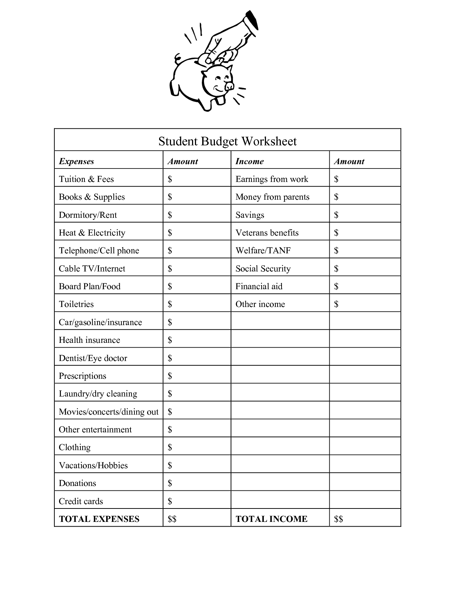
Budget Worksheet – College Students

Slide 10
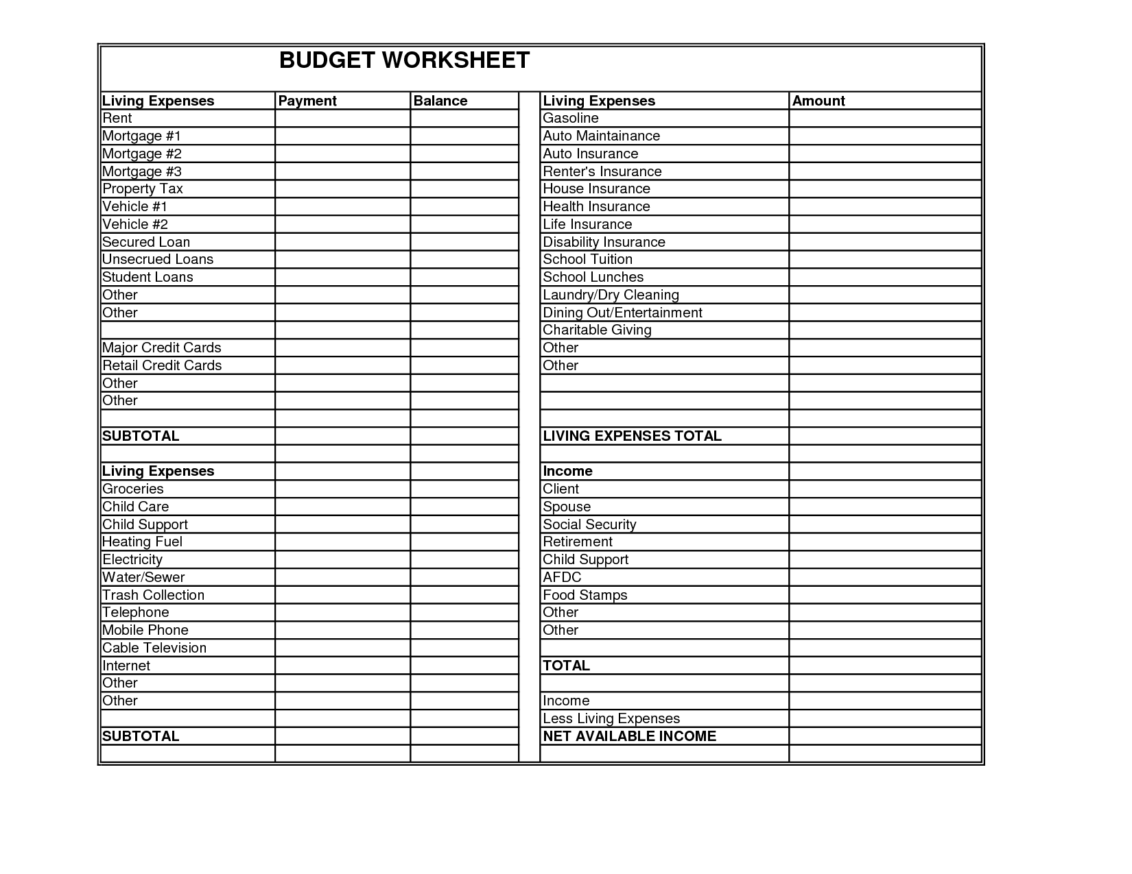
Budget Worksheet – Working after high school.

Slide 11
4. Letters of Recommendations - Get two letters or recommendations for work or college. The letter should address the college/job you are applying for after high school. It can be from a teacher, counselor, or supervisor (if you are employed). *Note: The rater of assignment (Dr. Arcega) cannot write a letter for this specific assignment because it would be a conflict of interest.

Slide 12
5. Letter of Interest (college or work) The letter explains to your reader how you became aware of the job opening or college. It expresses your desire to fill the job or attend the specific college. Impress the reader with your qualifications and achievements (academics, work ethics, good citizenship, and). Letter of Interest Links https://www.thebalance.com/letter-of-interest-tips-and-samples-2059708 https://theinterviewguys.com/how-to-write-a-letter-of-interest http://law.uga.edu/cover-lettersletters-interest

Slide 13
6. Resume Here are some reasons why you should have a resume: 1. Its usually expected, and if not expected it will be appreciated. 2. Employers want to see a concise list of your previous experience, abilities, accomplishments, and references. 3. A resume can be a tool used in an interview, as your potential employer will likely have it right in front of him or her, using it as a guide for prompting you to elaborate on your skills or as confirmation that you possess the experience required for the position. 5. Leaving your resume with a potential employer can serve as a reminder that you are an excellent candidate, either for the position at hand or for another one down the road.

Slide 14
Project Information & Format All the directed format and instructions need to be followed for full credit. The documents (i.e., flowchart, budget sheet) must be well written, clean, and not folded or wrinkled. Use the templates on the web: http://aarcega.weebly.com/

