Slide 1
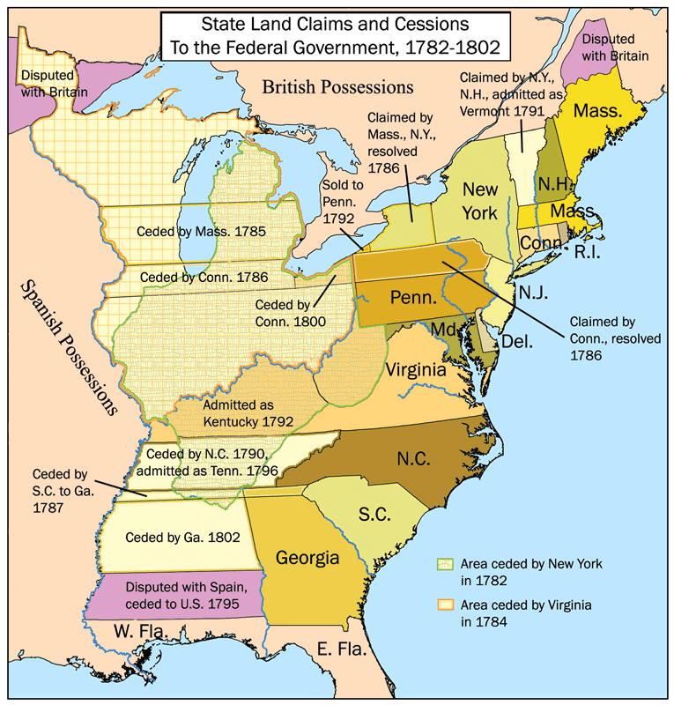
“Govern a New Colony”

Slide 2
The Scenario Your group have been chosen to lead (political and economic) one the 13 colonies after the American Revolution.

Slide 3
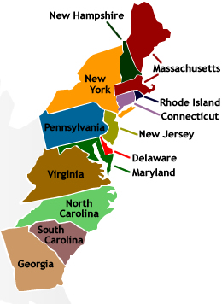
Each group will be assigned one of the 13 colonies to govern. Use the textbook for the social, political, and economic description of each colony.

Slide 4
The following questions will need to be answered during the “share-out.” 1. What will be the goals of the new government to insure it’s peace and prosperity? 2. How will the group maintain it’s authority and prevent a mutiny? 3. How will the group insure their survival (food/water, shelter, military/police/medical)? 4. What economic activities will the group pursue (use the textbook to find the economic activities (i.e., agriculture, fishing, cattle ranching) in the region/state) to insure it thrives economically? 5. What would happen to your government if your group loose control of its power?

Slide 5
Steps One through Five (1 – 5) Step 1. Brainstorm - Each group will work together in generating a mission statement and answers for the group questions. Step 2. Make a List – List the things or ideas that are generated from the brainstorm activity. Step 3. Create a Graphic Organizer (flowchart, concept web, Venn Diagram) - Use a blank sheet of paper to draw the graphic organizer. Input the things or ideas from the list. (See Graphic Organizer Procedure) Step 4. Write a Group Essay (400 words essay) – It will disclose the mission statement and describe how the group will govern their people. Each person in the group will be responsible for their share of the essay (See Essay Procedure) It should have an introduction, body, and conclusion. Step 5. Share Out – The group will share their group work with the class. (See Share-Out Procedure)

Slide 6
Essay Procedure The 400 words essay must be divided. The example below can be used in the following manner: Introduction – 100 words (1 person) Body – 200 words (2 people, 100 words per person) Conclusion – 100 words (1 person) Note: Each person must write their name in parenthesis with the number of words used before each paragraph. See the essay example in the next slide.

Slide 7
Introduction (Peter Smith – 100 words) The shared philosophical strategy that combines bilingual education program which promotes the development of two languages and English as a Second Language programs could have some similarities in terms of teaching strategies. Both focus on teaching language to students. They both focus on developing language skills for reading and writing. Body (Joe Wilson – 100) English Language Learner needs to learn English in an appropriate learning environment. Special education is different and some of the teaching strategies are different from teaching strategies in language. There are many levels in special education so it requires the gamut of teaching strategies to accommodate the students’ learning disabilities. Funding could be a greatest advantage in combining special education with bilingual education and English as a second language program. Special education gets a greater amount of funding than bilingual education and ESL. The pedagogical ideals and teaching strategies that are used in all three programs could benefit the students. (Susan Jimenez – 100) Funding could be a greatest advantage in combining special education with bilingual education and English as a second language program. Special education gets a greater amount of funding than bilingual education and ESL. The pedagogical ideals and teaching strategies that are used in all three programs could benefit the students. Funding could be a greatest advantage in combining special education with bilingual education and English as a second language program. Special education gets a greater amount of funding than bilingual education and ESL. The pedagogical ideals and teaching strategies that are used in all three programs could benefit the students. Conclusion (Susan Jimenez – 100) The three programs used to assist English Language Learner students are easy to use. They are meaningful teaching strategies that promote cognitive development through practical and easy to understand teaching strategies. The English Language Learner and Special Education departments can collaborate with each other through Professional Learning Community learning environments.

Slide 8
Graphic Organizer Procedure (Flowchart, Concept Web) Use the things or ideas from the generated list to fill and categorize the graphic organizer. (See Examples Below)

Slide 9
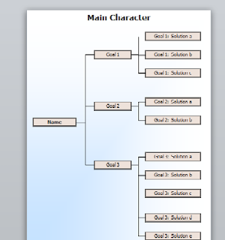
Example: Flow chart

Slide 10
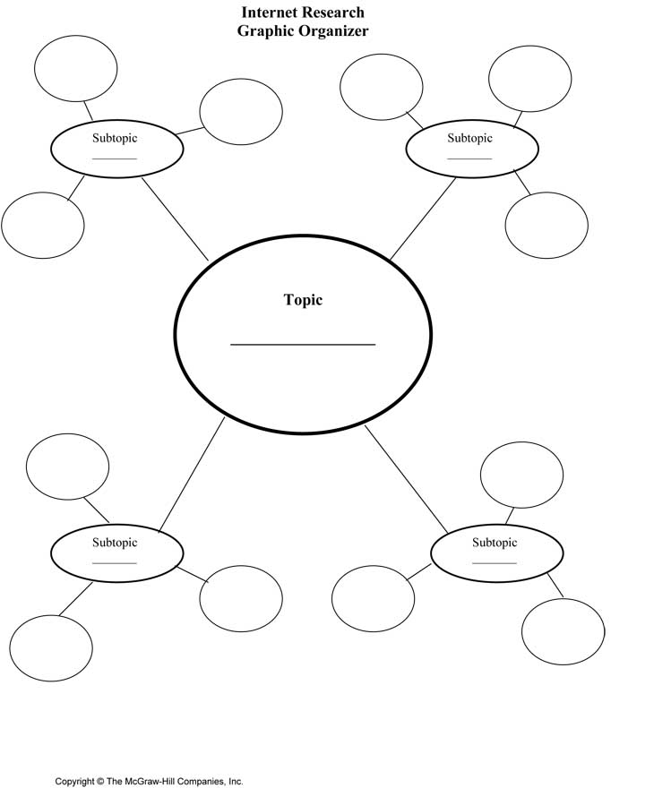
Example: Concept Web with sub- topics

Slide 11
“Share-Out” Procedure Each group will “share-out” their group work with the class. The instructor will provide further detail. Group members are expected to talk about their part of the group work. Groups are expected to also use the white board to draw and illustrate their graphic organizer. It will be used to provide a visual effect of their group work.

Slide 12
What is graded? 1. Graphic Organizer (1 per group) 2. Group Essay (400 words) Each group member must show their work (full name & number of words) on the essay. 3. Group Presentation - Students will explain their work (essay & graphic organizer). 4. “The Process” (Participation) – The Instructor will monitor the students working in groups. Student that are not working will not get participation points and no credit for the assignment. Make sure you are working and contributing to the process!

Slide 13
1. Virginia 2. Massachusetts 3. New Hampshire 4. Maryland 5. Connecticut 6. Rhode Island 7. Delaware 8. North Carolina 9. South Carolina 10. New Jersey 11. New York 12. Pennsylvania 13. Georgia
Assigned Groups

Slide 14
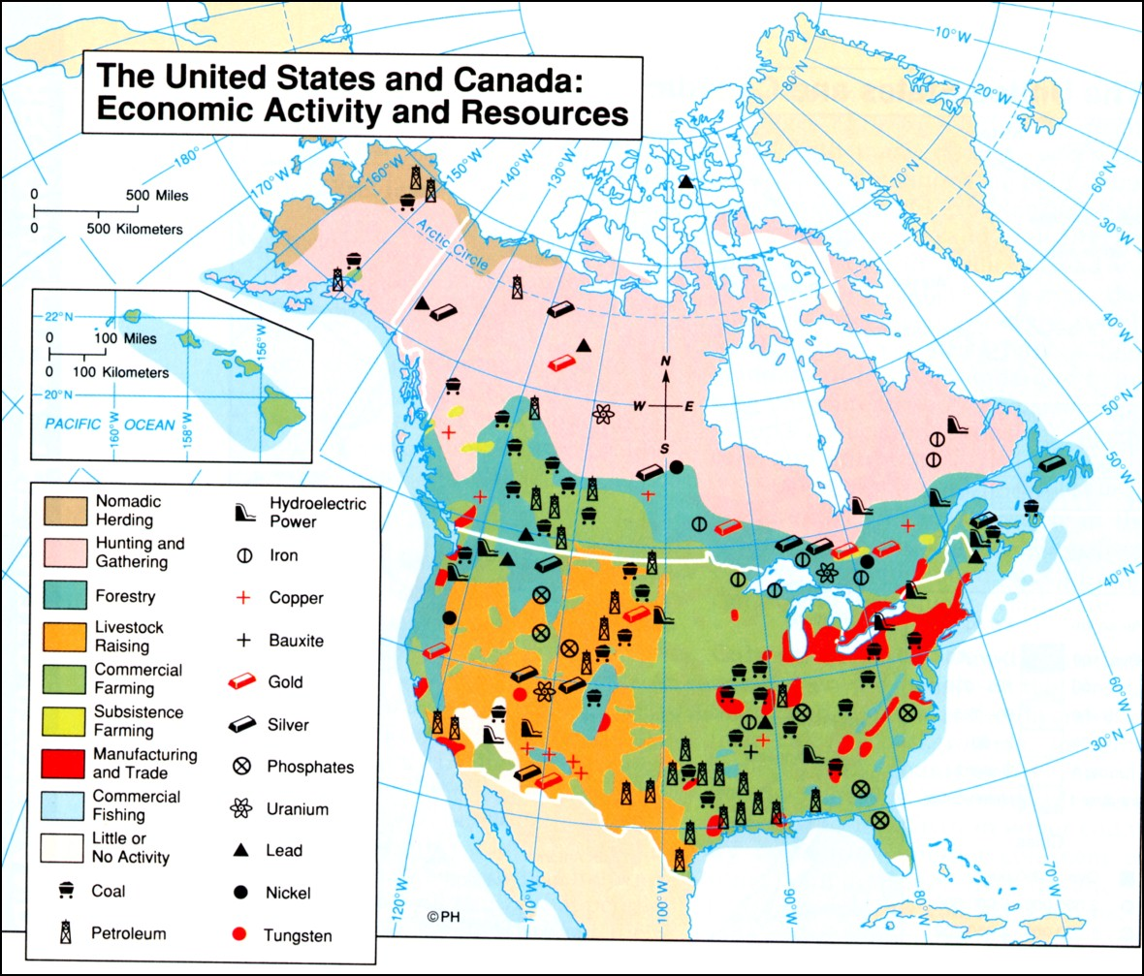
Economic Activity

