Slide 1
“Create a new Constitution”

Slide 2
The Scenario There were many problems that faced a new high school (factitious high school). The faced the following problems: - Poor Attendance (high truancy rate) - Safety (students/employees do not feel safe ) - Bullying - Gangs (violence, drugs, graffiti) - Fair/equal treatment (students/employees) Your group will create a solution by creating a new Constitution for the school. The Constitution will address the problems and prevent future problems.

Slide 3
Steps One through Five (1 – 5) Step 1. Brainstorm - Each group will work together in generating some new ideas that would fix the problems. Step 2. Make a List – Create a list of the ideas. The listed ideas can be used for the flowchart and essay. Step 3. Create a Graphic Organizer (Concept Web) - Use a blank sheet of paper to draw the graphic organizer. Write the different areas (Preamble, Articles, solutions) that need to be addressed in the new Constitution. Use the textbook to see an example of how the U.S. Constitution (Ch. 3) is formatted for ideas. Do not copy it. If you copy it, your group will get no credit for the assignment. Step 4. Write a Group Essay (500 words essay) – It will reflect the different sections and solutions. Each person in the group will be responsible for their share (125 words per person) of the essay. Step 5. Share Out –The group work will be shared out in class.

Slide 4
The following sections of the constitution will need to be addressed. 1. Preamble - (Write “mission statement” that highlight the goals of the new constitutions) 2. Articles – Create four (4) Articles that explain the different duties. Explain what each department will do to fix the problems of the school: I. Administration II. Counselors III. Teachers IV. Support Staff (security, office workers)

Slide 5
Essay Procedure The 500 words essay must be divided. The example below can be used in the following manner: Introduction – 125 words (1 person) Body – 250 words (2 people, 125 words per person) Conclusion – 125 words (1 person) Note: Each person must write their name in parenthesis with the number of words used before each paragraph. See the essay example in the next slide.

Slide 6
Introduction (Peter Smith – 125 words) The shared philosophical strategy that combines bilingual education program which promotes the development of two languages and English as a Second Language programs could have some similarities in terms of teaching strategies. Both focus on teaching language to students. They both focus on developing language skills for reading and writing. Body (Joe Wilson – 125) English Language Learner needs to learn English in an appropriate learning environment. Special education is different and some of the teaching strategies are different from teaching strategies in language. There are many levels in special education so it requires the gamut of teaching strategies to accommodate the students’ learning disabilities. Funding could be a greatest advantage in combining special education with bilingual education and English as a second language program. Special education gets a greater amount of funding than bilingual education and ESL. The pedagogical ideals and teaching strategies that are used in all three programs could benefit the students. (Susan Jimenez – 125) Funding could be a greatest advantage in combining special education with bilingual education and English as a second language program. Special education gets a greater amount of funding than bilingual education and ESL. The pedagogical ideals and teaching strategies that are used in all three programs could benefit the students. Funding could be a greatest advantage in combining special education with bilingual education and English as a second language program. Special education gets a greater amount of funding than bilingual education and ESL. The pedagogical ideals and teaching strategies that are used in all three programs could benefit the students. Conclusion (Susan Jimenez – 125) The three programs used to assist English Language Learner students are easy to use. They are meaningful teaching strategies that promote cognitive development through practical and easy to understand teaching strategies. The English Language Learner and Special Education departments can collaborate with each other through Professional Learning Community learning environments.

Slide 7
Graphic Organizer Procedure (Graphic Organizer) Use the things or ideas from the generated list to fill and categorize the graphic organizer. (See Examples Below)

Slide 8
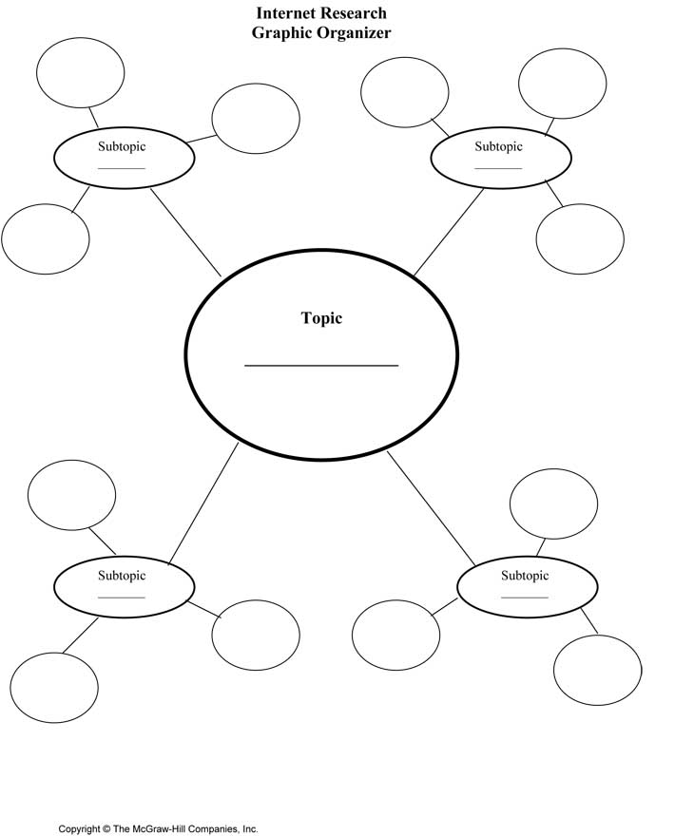
Concept Web with sub- topics

Slide 9
“Share-Out” Procedure Each group will “share-out” their group work with the class. The instructor will provide further detail. Group members are expected to talk about their part of the group work. Groups are expected to also use the white board to draw and illustrate their graphic organizer. It will be used to provide a visual effect of their group work.

Slide 10
What is graded? 1. Graphic Organizer (1 per group) 2. Group Essay (500 words) Each group member must show their work (full name & number of words) on the essay. 3. Group Presentation - Students will explain their work (essay & graphic organizer). 4. “The Process” (Participation) – The Instructor will monitor the students working in groups. Student that are not working will not get participation points and no credit for the assignment. Make sure you are working and contributing to the process!

