Slide 1
Investing in Equities Project

Slide 2
What is the Purpose of this project? This project will help students understand how to invest in equities (stock market). Economics Textbook: Chapter 11, Lesson 3

Slide 3
The Scenario - You are a stock broker in a stock brokerage company (licensed to buy and sell stocks). Your company has a client that wants to invest $50,000 in the stock market (Equities). As a stock broker, your job is to work with another stock broker in your company to find ten (10) profitable companies in the stock market (i.e., New York Stock Exchange, NASDQ) for your client.

Slide 4
Project Requirement It consist of the following: - Stock Portfolio (PowerPoint 10-12 slides) with the stocks selected for the $50,000 investment. - Stock Purchase Worksheet (hard copy) The selected stocks should be diversified (different sectors of business). See example of pie chart. - Diversified Pie Chart (MS Excel) *Submit the PowerPoint Portfolio to the instructor on the due date.

Slide 5
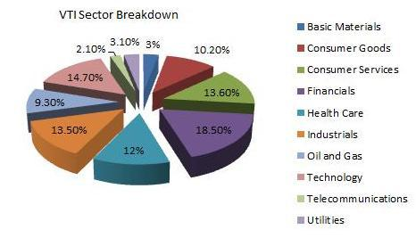
Diversified Portfolio

Slide 6
Example on how to fill-out all ten (10) slides.

Slide 7
Stock Portfolio Cover Page Student(s) full name(s) Period # Date:

Slide 8
Stock Pick # What is the name of the company? Coca-Cola Stock Price: $53.49 (Date: 10-16-19) How much dividend (per share/per year) does the company pay? $1.60 What is the P/E (Price/Earnings)? 32 What is the 52 week high/low price? $44.42-55.92
Template/Example

Slide 9
Stock Pick # 1 1. What is the name of the company? 2. How much dividend (per share/per year) does the company pay? 3. What is the P/E (Price/Earnings)? 4. What is the 52 week high/low price?
Company Logo goes here

Slide 10
Stock Pick # 2 1. What is the name of the company? 2. How much dividend (per share/per year) does the company pay? 3. What is the P/E (Price/Earnings)? 4. What is the 52 week high/low price?
Company Logo goes here

Slide 11
Stock Pick # 3 1. What is the name of the company? 2. How much dividend (per share/per year) does the company pay? 3. What is the P/E (Price/Earnings)? 4. What is the 52 week high/low price?
Company Logo goes here

Slide 12
Stock Pick # 4 1. What is the name of the company? 2. How much dividend (per share/per year) does the company pay? 3. What is the P/E (Price/Earnings)? 4. What is the 52 week high/low price?
Company Logo goes here

Slide 13
Stock Pick # 5 1. What is the name of the company? 2. How much dividend (per share/per year) does the company pay? 3. What is the P/E (Price/Earnings)? 4. What is the 52 week high/low price?
Company Logo goes here

Slide 14
Stock Pick # 6 1. What is the name of the company? 2. How much dividend (per share/per year) does the company pay? 3. What is the P/E (Price/Earnings)? 4. What is the 52 week high/low price?
Company Logo goes here

Slide 15
Stock Pick # 7 1. What is the name of the company? 2. How much dividend (per share/per year) does the company pay? 3. What is the P/E (Price/Earnings)? 4. What is the 52 week high/low price?
Company Logo goes here

Slide 16
Stock Pick # 8 1. What is the name of the company? 2. How much dividend (per share/per year) does the company pay? 3. What is the P/E (Price/Earnings)? 4. What is the 52 week high/low price?
Company Logo goes here

Slide 17
Stock Pick # 9 1. What is the name of the company? 2. How much dividend (per share/per year) does the company pay? 3. What is the P/E (Price/Earnings)? 4. What is the 52 week high/low price?
Company Logo goes here

Slide 18
Stock Pick # 10 1. What is the name of the company? 2. How much dividend (per share/per year) does the company pay? 3. What is the P/E (Price/Earnings)? 4. What is the 52 week high/low price?
Company Logo goes here

Slide 19
Example of Diversified Stock Pie Chart

