Slide 1
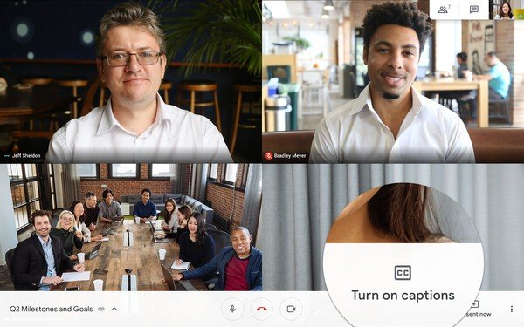
Google Meet Tutorial in English and Spanish

Slide 2
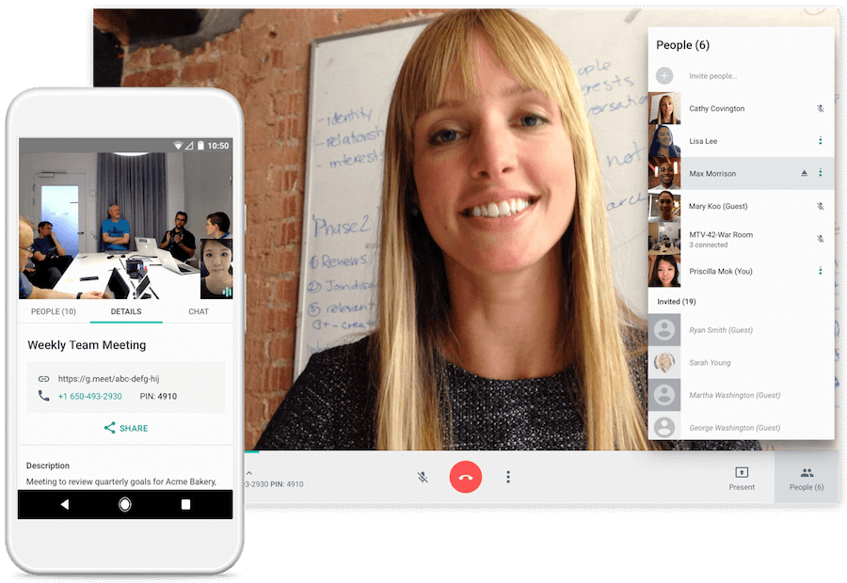
How to use Google Meet through a tutorial. Use the links below. https://www.youtube.com/watch?v=wGXI0KpkR50 https://www.youtube.com/watch?v=RY9epgWvCCU

Slide 3
Spanish Version - How to use Google Meet through a tutorial. Use the link below. https://www.youtube.com/watch?v=fw1a2t_AeIo https://www.youtube.com/watch?v=9aN0BZB7exY

