Slide 1
NEWS BROADCAST PROJECT HISTORICAL EVENTS

Slide 2
Historical Events (Video) - It will require four (4) students per group. - The news will be based on a historical event(s). - The news will replicate the news broadcast during the assigned time period.

Slide 3
Project Requirements 1. Video Clip (5-7 minutes) - Each group will use a video camera or the camera on a phone to create the video. 2. Essay (500 words per topic) Two topics will require two separate 500 words essay per group. 3. Share-out the videos

Slide 4
Time Management - Each group must create a video clip that is at least 5-7 minutes. Anything below 5 minutes or above 7 minutes will result in getting points subtracted. *Make sure to use a timer to stay within the timeframe.

Slide 5
What should be on the Video Clip? - Each group will summarize the two (2) specific topics/event(s). - Each group will summarize their essay (500 words) in the news broadcast. In other words, it will require the student to only read key points from their essay to stay within the time frame.

Slide 6
Example of Two Events per Group Event # 1. Cuba Missile Crisis (Essay with 500 words for two Students) Student # 1: What caused it? Student # 2: What was the result/effects? Event # 2. Berlin Airlift (Essay with 500 words for two Students) Student # 3: What caused it? Student # 2: What was the result/effects?

Slide 7
What should you wear? The project will simulate as a real “news report.” The news reporters should dress-up to present the news for a good grade.

Slide 8
Newsroom Setting It should be done in a quiet place to simulate a news room. Background – White sheet Furniture – Table and chairs

Slide 9
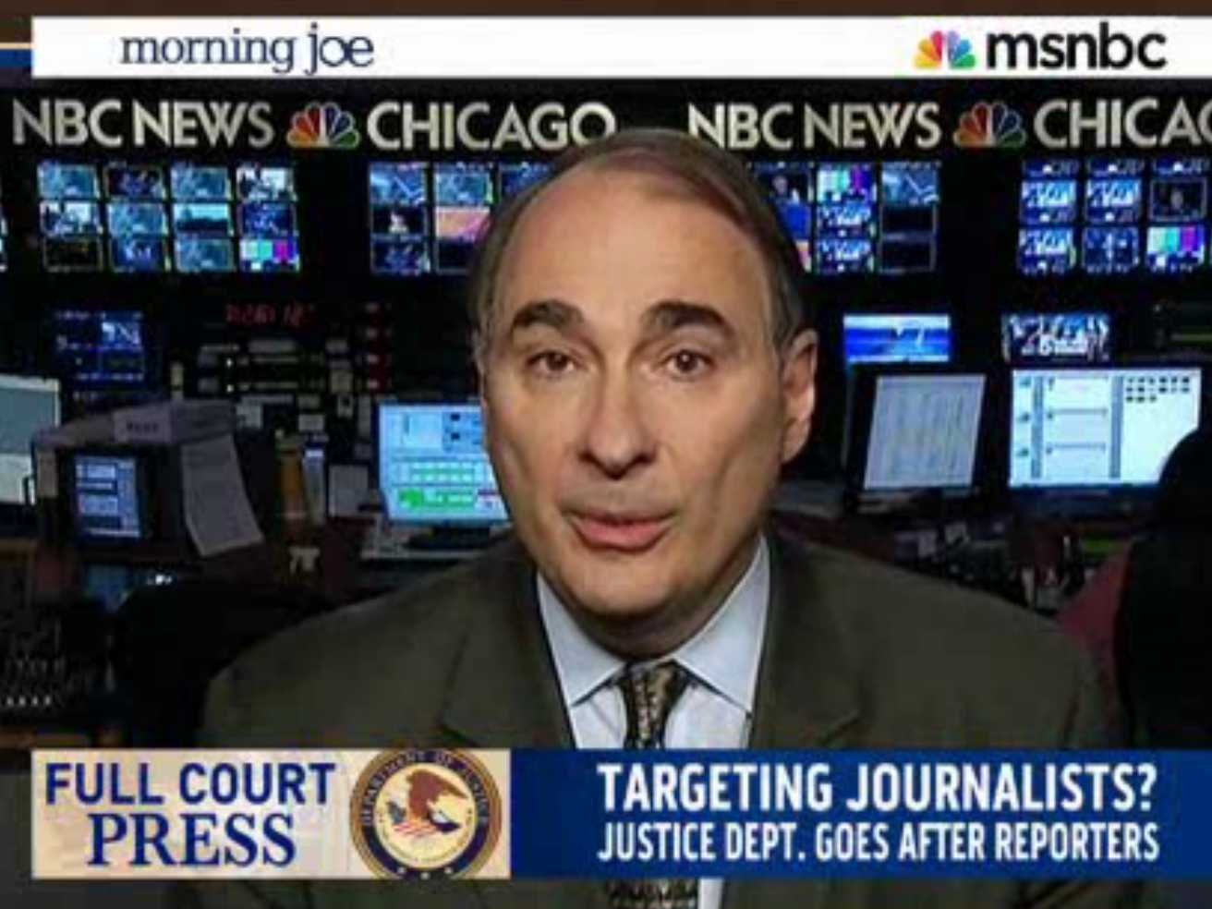
Suggestion Watch various nightly news to get an idea of the format used in presenting the news.

Slide 10
Essay (500 words per Topic) Each group will need two (2) separate essays since there are two topics. Each topic will require an essay (500 words). It should be a well written essay (introduction, body, conclusion). See the essay template on: dr.aarcega@weebly.com

Slide 11
Introduction The introductory paragraph is the thesis statement (the sentence that states the main idea). It tells the reader what the essay is about. The last sentence of this paragraph must also contain a transitional "hook" which moves the reader to the first paragraph of the body of the paper. Body The supporting paragraphs to your introduction paragraph and to your thesis statement. Conclusion Restate the main idea of your essay, or your thesis statement. Summarize the three sub-points of your essay.

Slide 12
Visual Aids Use pictures or other visual effect to enhance your news report. Use the following visuals: -Charts, Graphs -Pictures -Graphic Organizers

