Slide 1
Student’s Name Jose Santos Civics Date: April 10, 2015 Period # ___ Supreme Court Case Name & Year: (Example) Baker v. Carr (1962)

Slide 2
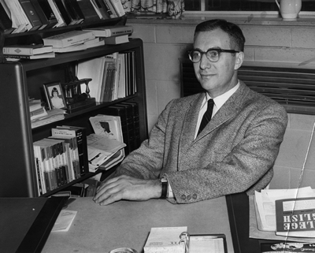
Pictures of key players in the case.
Charles W. Baker - Plaintiff

Slide 3
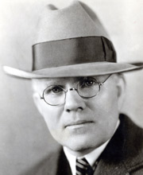
Joe C. Carr - Tennessee Secretary of State - Defendant

Slide 4
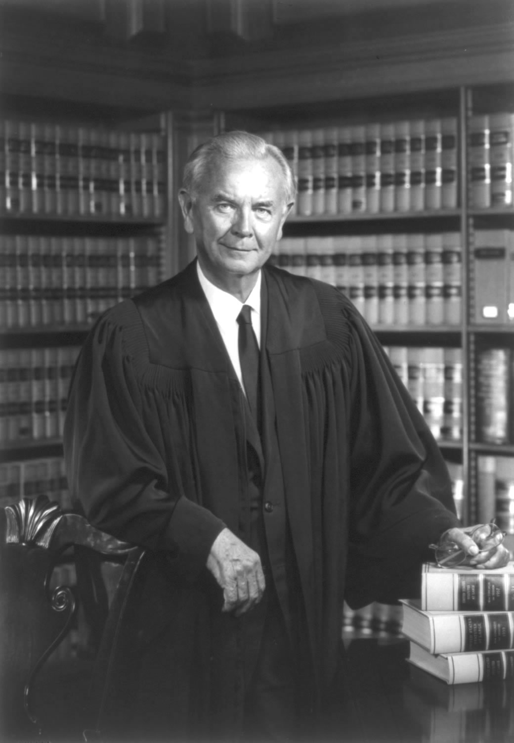
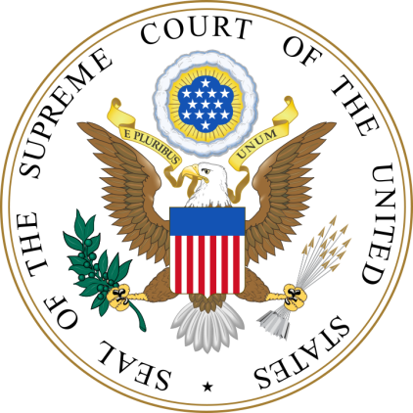
William J. Brennan, Jr. – Chief Justice

Slide 5
Background of the Case: In the State legislature of Tennessee, representation was determined by a 1901 law setting the number of legislators for each county. Urban areas, which had grown greatly in population since 1901, were underrepresented.

Slide 6
(Background of the Case continued) Mayor Baker of Nashville brought suit, saying that the apportionment denied voters of urban areas equal protection of the law as guaranteed by the 14th Amendment. The federal court refused to enter the “political thicket” of State districting, and the case was appealed to the Supreme Court.

Slide 7
The Question(s) presented to the Court: The case presented two question: 1.Did Congress have the authority to establish the bank? 2.Did the Maryland law unconstitutionally interfere with congressional powers?

Slide 8
Court’s Ruling - Decision In a 6-2 ruling, the Supreme Court held that federal courts have the power to determine the constitutionality of a State's voting districts.

Slide 9
Court’s Opinion (Majority Opinion) Justice William J. Brennan, Jr., wrote the majority opinion, stating that the plaintiffs' constitutional right to have their votes count fairly gave them the necessary legal interest to bring the lawsuit. He argued that the case did not involve a “political question” that prevented judicial review.

Slide 10
Concurring Opinion Justice William O. Douglas wrote a concurring opinion. He declared that if a voter no longer has “the full constitutional value of his franchise [right to vote], and the legislative branch fails to take appropriate restorative action, the doors of the courts must be open to him.”

Slide 11
In a dissenting opinion, Justice John Harlan II argued that the federal equal protection clause does not prevent a State “from choosing any electoral legislative structure it thinks best suited to the interests, temper, and customs of its people.”

Slide 12
Dissenting Opinion Justice John Harlan II argued that the federal equal protection clause does not prevent a State “from choosing any electoral legislative structure it thinks best suited to the interests, temper, and customs of its people.”

Slide 13
If a State chose to “distribute electoral strength among geographical units, rather than according to a census of population,” he wrote, that choice “is…a rational decision of policy…entitled to equal respect from this Court.”

Slide 14
Consequences of the decision Having declared redistricting issues justifiable in Baker, the court laid out a new test for evaluating such claims. The Court formulated the famous “one person, one vote” standard under American jurisprudence for legislative redistricting, holding that each individual had to be weighted equally in legislative apportionment. This affected numerous state legislatures that had not redistricted congressional district for decades, despite major population shifts. It also ultimately affected the composition of state legislative districts as well, which in Alabama and numerous other states had overrepresented rural districts and underrepresented urban districts with much greater population.

Slide 15
References (Examples) Magazine Reference Beck, B. E. (1999, July). Style and modern writing [Special issue]. Prose Magazine, 126, 96-134. Book Reference Gode, S. M., Orman, T. P., & Carey, R. (1967). Writers and writing. New York: Lucerne Publishing. Internet Reference Bernstein, M. (2002). 10 tips on writing the living Web. A List Apart: For People Who Make Websites, 149. Retrieved from http://www.alistapart.com/articles/writeliving

