Slide 1
Supreme Court Cases Project

Slide 2
1. Groups - Four (4) students per group. Each group will get Four (4) separate cases. Each person is expected to do one case. Students are placed into groups for time saving and scheduling purposes. Students do not have to work together as an actual group. 2. PowerPoint (10 to 12 slides) – Each student must have a USB Memory Drive to load their presentation into class computer. The case(s) can be loaded individually or as a group. 3. Visuals – Provide picture of the people key people involved in the case (i.e., Plaintiff, Defendant, Chief Justice) in the case. 4. Presentation – Each student in the group will be expected to present a summary of the following sections of their case: 1. Court’s Opinion (Majority) 2. Concurrence Opinion 3. Dissention Opinion

Slide 3
Presentation Requirements USB Memory Device Due to poor WiFi reception, Google Docs will not work in class. Each group will need to load their Power Point presentation manually through the USB Memory Device. It must be loaded into the class computer one day before the presentation date to make sure it works properly. Oral Presentation -Loud, clear, look at the audience. Index Cards Each student must have 5-6 index cards with a summary of their case. Visual Aides Pictures of the Plaintiff(s), Defendant(s), Chief Justice and any other pictures that can enhance the presentation. Each (per person) Presentation Time - Three (3) minutes minimum - Five (5) minutes maximum

Slide 4
Evaluation value (300 Points) Essay -300 Words Essay (150 Points) (Use the Essay format with a checklist on the website.) - Presentation (50 Points) - Facts & Information -Presentation (Loud, clear, eye contact with the audience) Index Cards 5-6 Cards (25 Points) Time Management (25 Points) Three to five (3 - 5) Minutes per person. Anything below or over will result in points deducted. Visual (picture, graphics of the topic) 25 Points Reference Page = 25 Points

Slide 5
Sample of a Supreme Court Case

Slide 6
Civics Date: April 12, 2015 Period # ___ Student’s Names Maria Ortiz - Supreme Court Case Name & Year

Slide 7
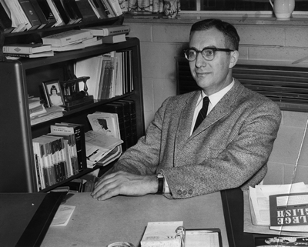
Charles W. Baker - Plaintiff

Slide 8
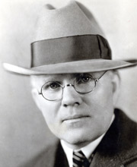
Joe C. Carr - Defendant
Tennessee Secretary of State

Slide 9
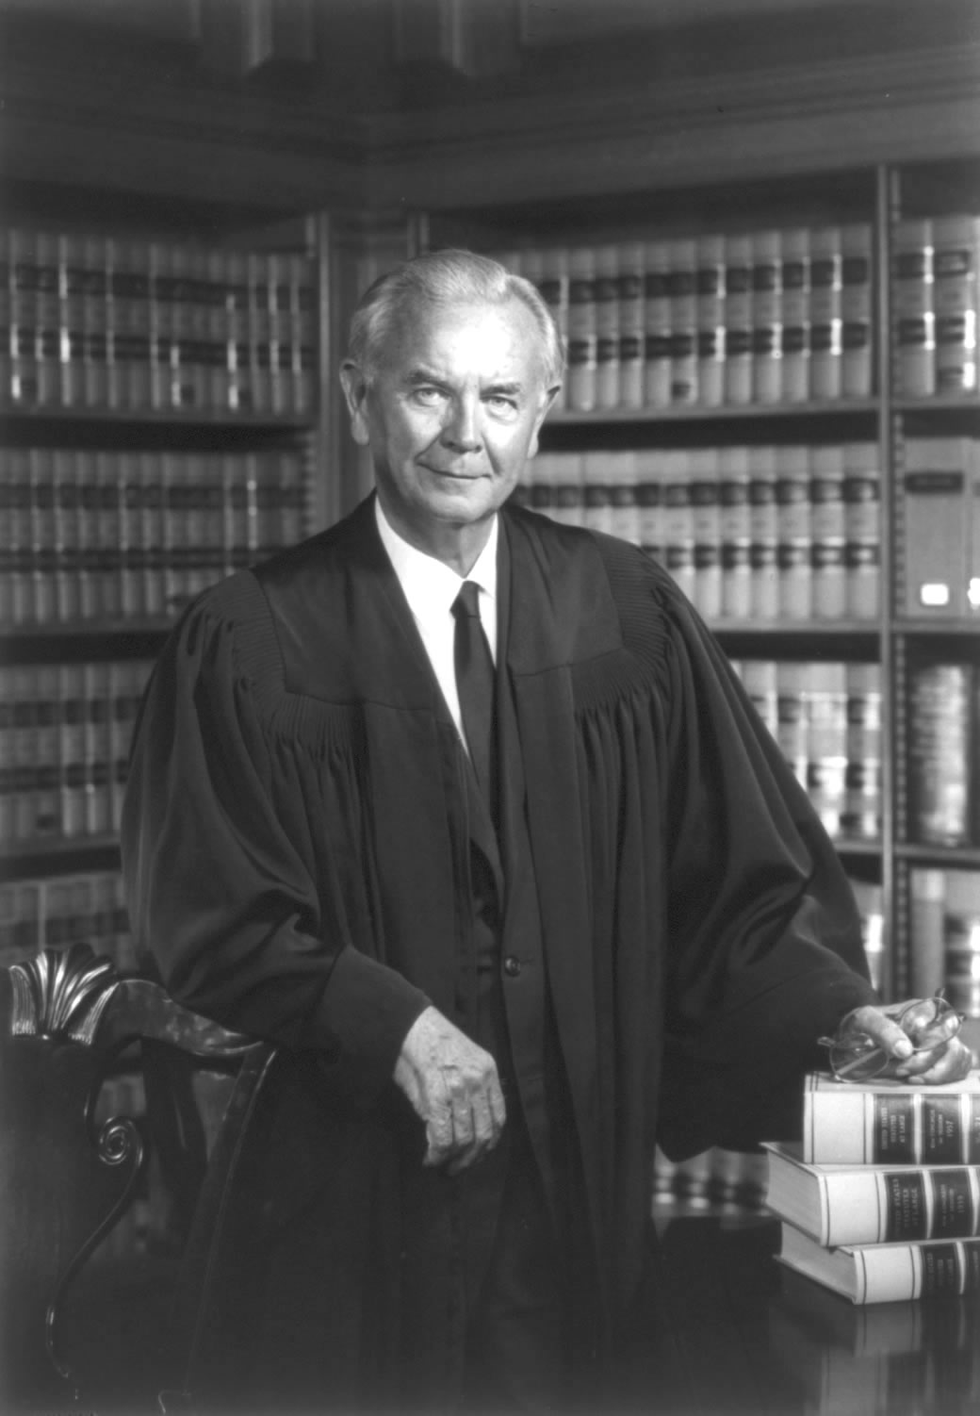
William J. Brennan, Jr. – Chief Justice of the Case

Slide 10
Background of the Case: Summarize the case (1-2 slides). It should answer some key questions (who, what, where, when, why) in the summary.

Slide 11
The Question(s) presented to the Court: - Write the main question(s) that needs to be answered by the Court. Example: The case presented the following question(s)…

Slide 12
Court’s Ruling – Decision - Write the numbers (6-3 majority ruling by the Court.)

Slide 13
Court’s Opinion - Majority Opinion - Write the majority opinion on the case. What is a Majority Opinion? It’s a judicial opinion agreed to by more than half of the members of a court. A majority opinion sets forth the decision of the court and an explanation of the rationale behind the court's decision.

Slide 14
Concurring Opinion - Write the concurring opinion of the Court. What is a Concurring Opinion? It’s a written opinion by one or more judges of a court which agrees with the decision made by the majority of the court, but states different reasons as the basis for his or her decision.

Slide 15
Dissenting Opinion - Write the dissenting opinion of the Court. What is a Dissenting Opinion? A dissenting opinion is an opinion in a legal case written by one or more judges expressing disagreement with the majority opinion of the court which gives rise to its judgment.

Slide 16
Consequences of the decision Write a summary of the consequences of the decision made by the court. Try to simplify the words that are used in the presentation. Also, make sure the word that are used in the presentation can be defined during the presentation. The instructor will ask questions about certain terminologies used in the case.

Slide 17
References (Format - See Examples)

Slide 18
Examples Magazine Reference Beck, B. E. (1999, July). Style and modern writing [Special issue]. Prose Magazine, 126, 96-134. Book Reference Gode, S. M., Orman, T. P., & Carey, R. (1967). Writers and writing. New York: Lucerne Publishing. Internet Reference Bernstein, M. (2002). 10 tips on writing the living Web. A List Apart: For People Who Make Websites, 149. Retrieved from http://www.alistapart.com/articles/writeliving

