Slide 1
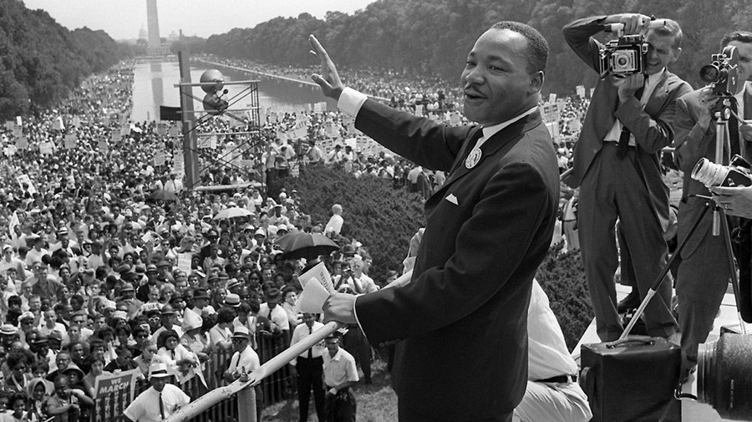
HISTORICAL EVENTS

Slide 2
Project Requirements 1. Group work (3-4 students) 2. Concept Web (1 per group) 3. Power Points (12-15 slides) with Data & Visuals (pictures) 4. Essay (1000 words) See the template 5. Group Presentation (4-6 minutes) 6. Index cards (must use the cards or no credit).

Slide 3
Group Presentation - Each group must present their power point for 4-6 minutes. Anything below 4 minutes or above 6 minutes will result in getting points subtracted. *Make sure to use a timer to stay within the timeframe.

Slide 4
Groups 1- Chapter 14, Section 1 2 - Chapter 14, Section 2 3 - Chapter 14, Section 3 4 - Chapter 15, Section 1 5 - Chapter 15, Section 2 6 - Chapter 15, Section 3 7 - Chapter 16, Section 1 8 - Chapter 16, Section 2 9 - Chapter 16, Section 3 10 - Chapter 16, Section 4

