Slide 1
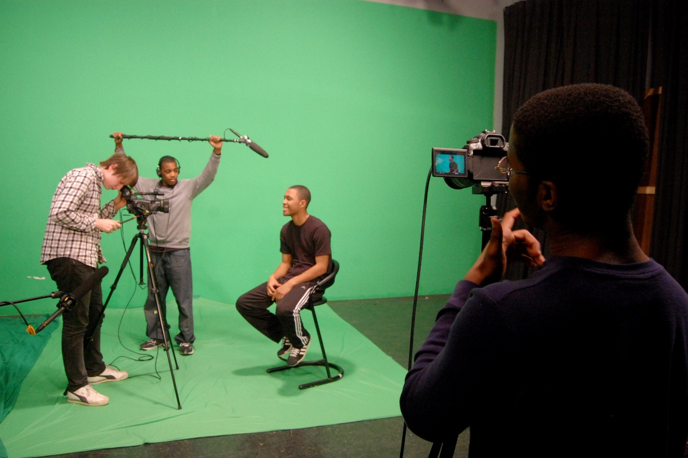
Group Video Project

Slide 2
Video Project Every student have sat through various videos in a classroom in school. Students have complained about class videos because they felt they were boring. Well, now it is your turn to be a creative video producer. Each group will be the mastermind behind the new and improved educational and informative video. The video must be related to the subject matter (i.e., Civics, Economics, History. All the requirements for this project are in the instructor’s website: http://aarcega.weebly.com/

Slide 3
Select a Topic Each group (4 students) will select a topic from the chapters from the textbook. I must be a chapter that was covered in class during the semester. The group can transform the topic into one of the listed video formats. - Minimum of four (4) minutes - Maximum of eight (8) minutes The time for the video will be strictly enforced so anything under the minimum or over the maximum will result in a lower grade.

Slide 4
Step 1 - Group Video Proposal
Each group will fill out a “Group Video Proposal.” Download the form from the website. It will be submitted to the instructor for an approval. The instructor will review the proposal to insure it is appropriate and related to the subject matter.

Slide 5
Step 2 - Google Slide
Each group will have to create a “Google Slide.” The slides will have to be shared with each group member and the instructor at: dr.aarcega@gmail.com The Google Slides will be used to present the video. See the example of the video slide in the website.

Slide 6
Step 3 - Create a “YouTube” video.
Each group will create a “YouTube” video. Follow the instructions from the “Create a YouTube video”. The video from YouTube will be uploaded to the Google slide. Use “Insert” from the menu. Select “Video” option to search and upload the video that the group created. The video can be deleted after the instructor grades the project.

Slide 7
Create a YouTube video

Slide 8
Step 4 – Select a Video Format The following video format can be used for the video project. It can be used to highlight, report, understand, recreate, advertise, or make a stand on something related to the subject matter. -Make a Trailer -News Broadcast (News from the past) -Comprehensive Video “How-To-Understand Video” -Recreate History -Highlight a “Cause and Effect”

Slide 9
Make a Trailer: Design a short movie-style trailer that excites the audience (your classmates) about a must-read topic from the textbook.

Slide 10
Create a “trailer video.”

Slide 11
News Broadcast: Students can recreate a news broadcast from the past. Pretend the news is being reported during the actual time when the event took place. The report can be about an important historical event.

Slide 12
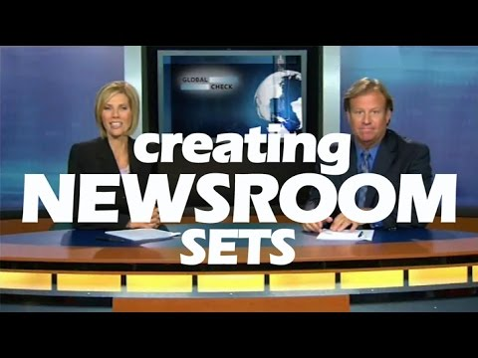
Create a Newsroom

Slide 13
“How-To- Learn Video”: Video that explain how to learn and understand complicated term(s) or concept(s) from the textbook. Look at YouTube “Why study government?” for an example.

Slide 14
Create a “How to Learn Video”

Slide 15
Recreate History: recreate a short skit during a historical moment in time and put it in a video format.

Slide 16
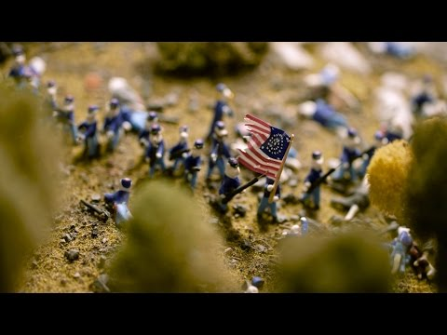
Recreate History

Slide 17
Cause and Effect Video of a historical moment — Find a historical event in the textbook (Instructor will provide the chapter selections). Talk about the cause and effect of the event in the video.

Slide 18
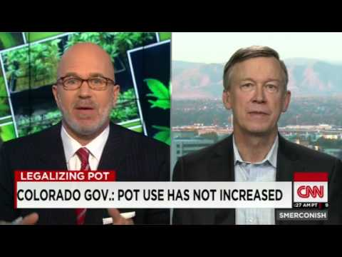
Cause and Effect Video

Slide 19
Procedures
1. Create a group video proposal (What is the video about?) Needs approval from instructor.
2. Create a Google slide
3. Create the video in YouTube
4. Upload the YouTube video to the Google slide.
5. Create the “Credits” slide (See example) for the last slide.

Slide 20
Credit Sheet Four (4) Students Student 1. Full Name: Student’s Contribution(s): Student 2. Full Name: Student’s Contribution(s): Student 3. Full Name: Student’s Contribution(s): Student 4. Full Name: Student’s Contribution(s):

Slide 21
What is graded? 1. Video Proposal Must be completed.
2. Video (Time frame: 4-8 minutes per group) 3. Group Contribution Each group member must show their contribution to the video.
4. Group Presentation - Students will do a brief summary before the video. 5. “The Process” (Participation) – The Instructor will monitor the students to make sure they are working. Students who are not engaged in the assignment will lose points. Make sure you are working! 6. Credits - Each group will include a “Credit” page in the end of the PowerPoint. This will list the student’s contributions to the video project.

