Slide 1
The Thought Process

Slide 3
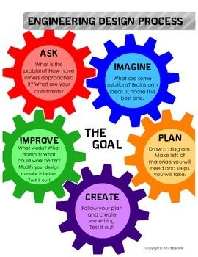
Designing Your Thoughts

Slide 4
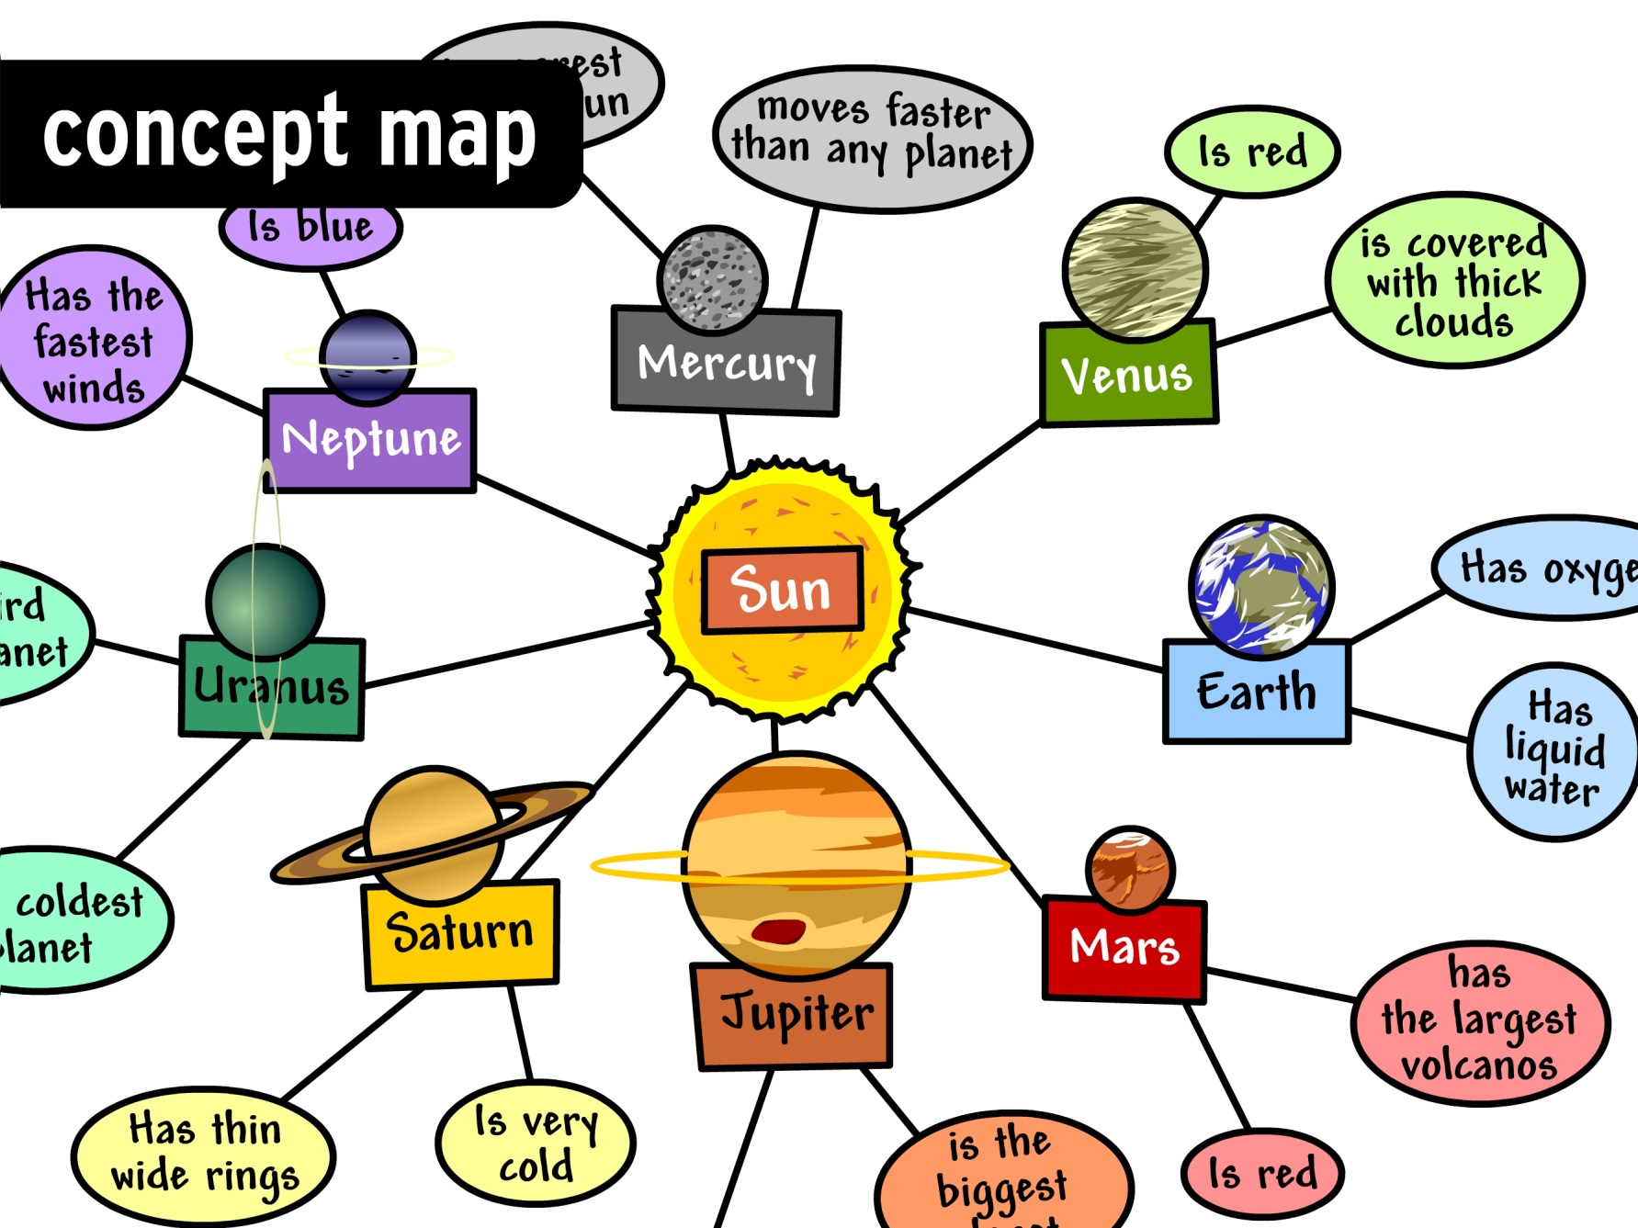
Concept Map

Slide 5
Cause Good morning/afternoon, This is Mr./Ms. Smith (student name) reporting from KNBC Channel 4 news on breaking news. There has been some recent event(s) in _place_. The event is taking place today (date/time). The people/person/event was describe the event. This event was caused by ________. It is important because it affects ________.

Slide 6
Effects Good morning/afternoon, This is Mr./Ms. Smith (student name) reporting from KNBC Channel 4 news on a follow-up on the news that was reported on (date) . There has been some recent developments to the event(s) that took place in _place_. The event has changed taking today (date/time). The people/person/event describe the event. The new development is important because it affects ________.

Slide 7
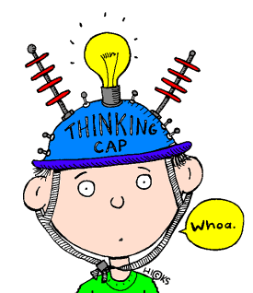
Thought (also called thinking) – the mental process in which beings form psychological associations and models of the world. Thinking is manipulating information, as when we form concepts, engage in problem solving, reason and make decisions.

Slide 8
